Slide 1
Intermediate Code Generation
Chapter 6

Slide 2
Intermediate Representation
Front End
Intermediate Code
Back End
Source Program
for Language i
Target Code
for Machine j

Slide 3
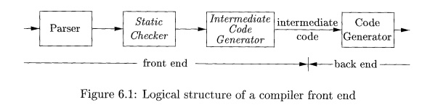
Intermediate Representation

Slide 4
Intermediate Representation
What is an Intermediate Representation (IR)?
Abstract Machine Language
Machine and Language independent version of source program
Can express target machine operation without committing too much machine specific details

Slide 5
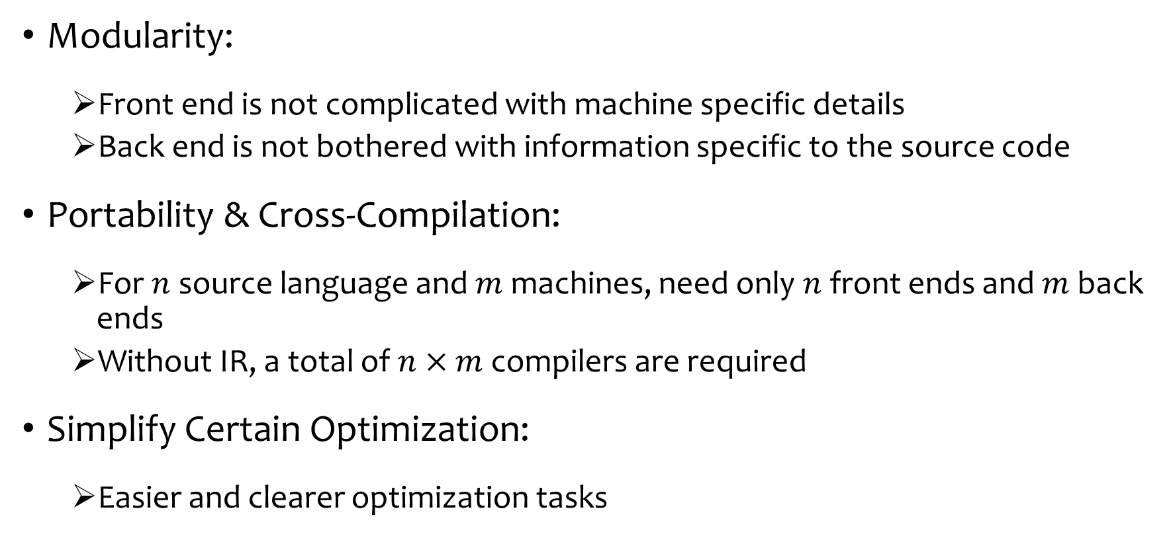
Why Need IR?

Slide 6
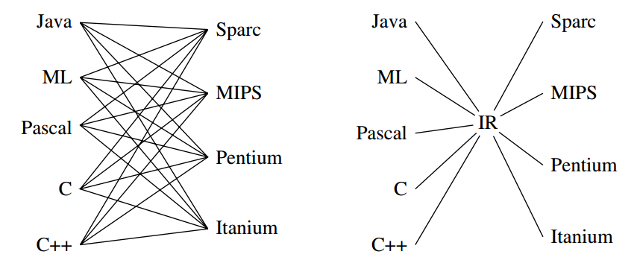
Why Need IR?
Figure Source: Modern Compiler Implementation in Java by Andrew Appel

Slide 7
Designing Good IR?
Balance between high-level source language and low level machine language
Often there are multiple IRs in a single compiler
Source Program
High Level IR
Low Level IR
Target Code
Close to Source
Language
Close to Machine
Language

Slide 8
Choice of an IR
The choice or design of an intermediate representation varies from compiler to compiler.
An intermediate representation may either be
an actual language or
it may consist of internal data structures that are shared by phases of the compiler.
C is a programming language, yet it is often used as an intermediate form because it is flexible, it compiles into efficient machine code, and its compilers are widely available.
The original C + + compiler consisted of a front end that generated C, treating a C compiler as a back end.
Another example: python compiler using C++ as an IR (https://github.com/Omyyyy/pycom)

Slide 9
High and Low Level IRs
High Level IRs:
Syntax Tree
DAG
Three Address Code with high level operators
Low Level IRs:
Three Address Code with low level operators

Slide 10

Variants of Syntax Trees
Syntax Tree:
Each node represents a construct of source program
Each children represent a meaningful component
Leaves correspond to atomic operands
Interior nodes correspond to operators
Syntax Tree for expression 9-5+2

Slide 11
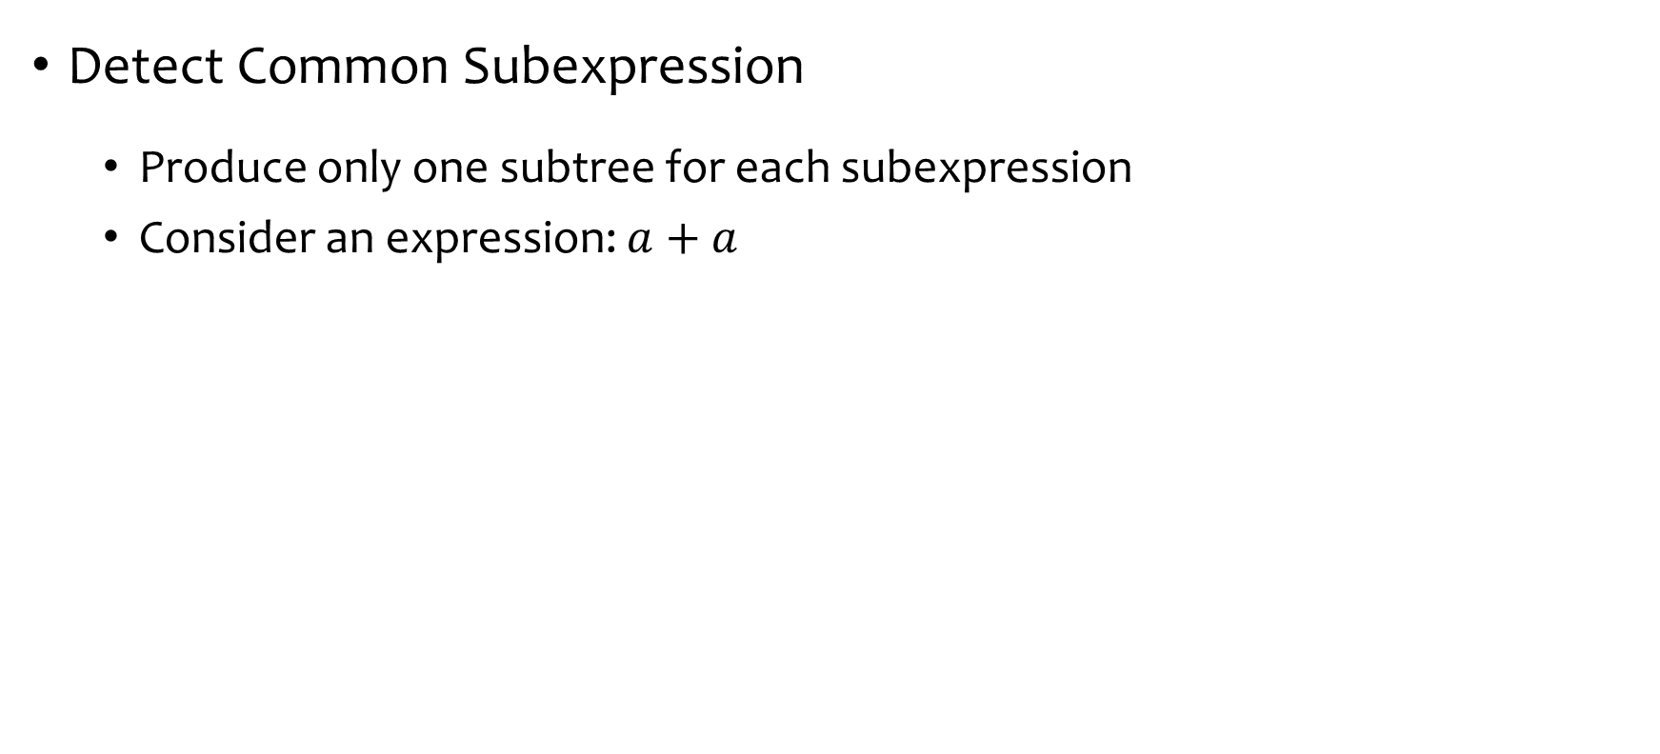
Directed Acyclic Graphs (DAG)
+
+
a
a
a
Common Subexpression
Single node for expression a
Syntax Tree
DAG

Slide 12
Directed Acyclic Graphs (DAG)
A Node N can have more than one parent
If it represent a common subexpression
Succinct Representation of Syntax Tree
Provide clues for generating efficient code

Slide 13
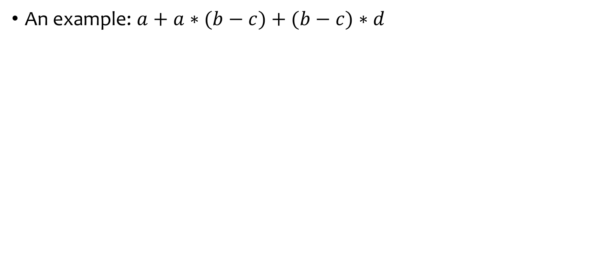













Directed Acyclic Graphs (DAG)
Syntax Tree

Slide 14

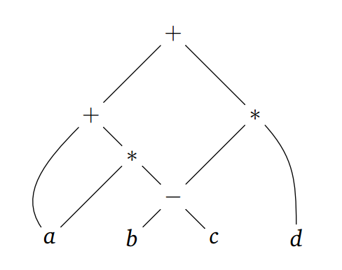












Directed Acyclic Graphs (DAG)
Syntax Tree
DAG

Slide 15
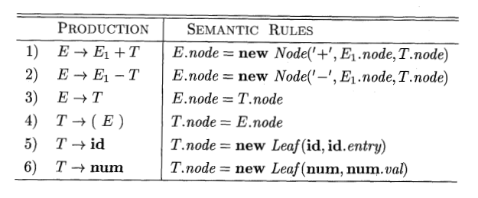
SDD for constructing DAG
Wait!! What?? This SDD constructs Syntax Tree!
The Leaf and Node functions will return a previously created identical node if exist, otherwise return a newly created one
Identical Node means the subtree rooted at that node is same

Slide 16
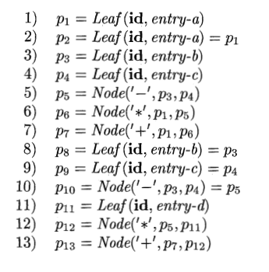
SDD for constructing DAG
Steps of constructing the left DAG

Slide 17
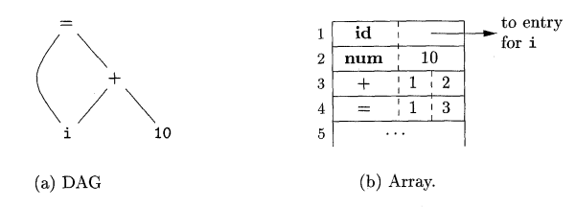
Value Number Method
Nodes of AST or DAG can be stored in array or records (structures)
Each row represent one record (one node)
Second Field of leaf node is lexical value
Second and Third Field of interior node contains index number of left and right child
First Field is an operation code (label of the node)

Slide 18
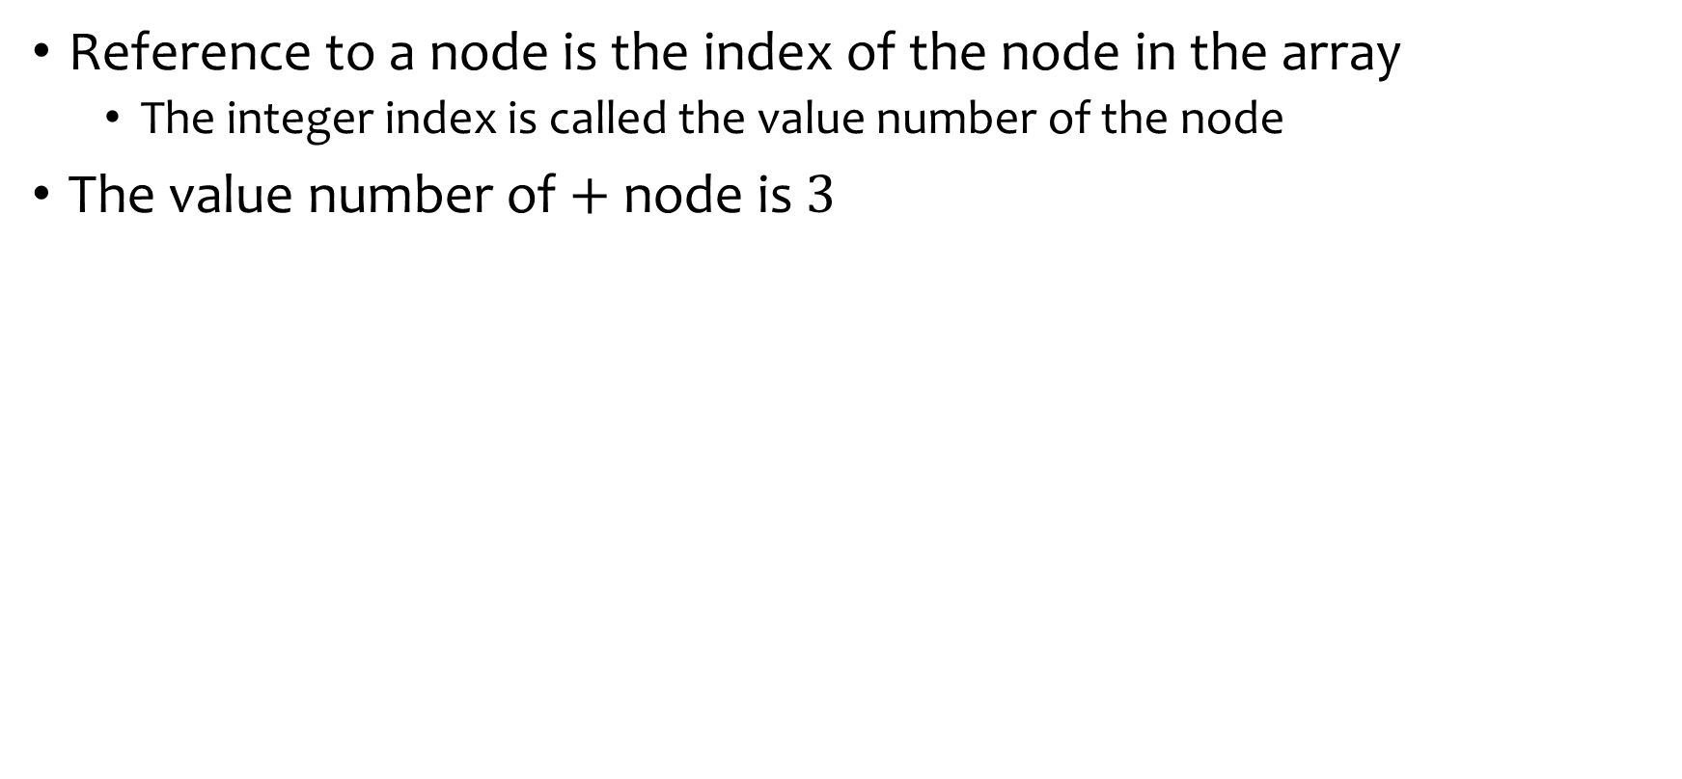
Value Number Method

Slide 19
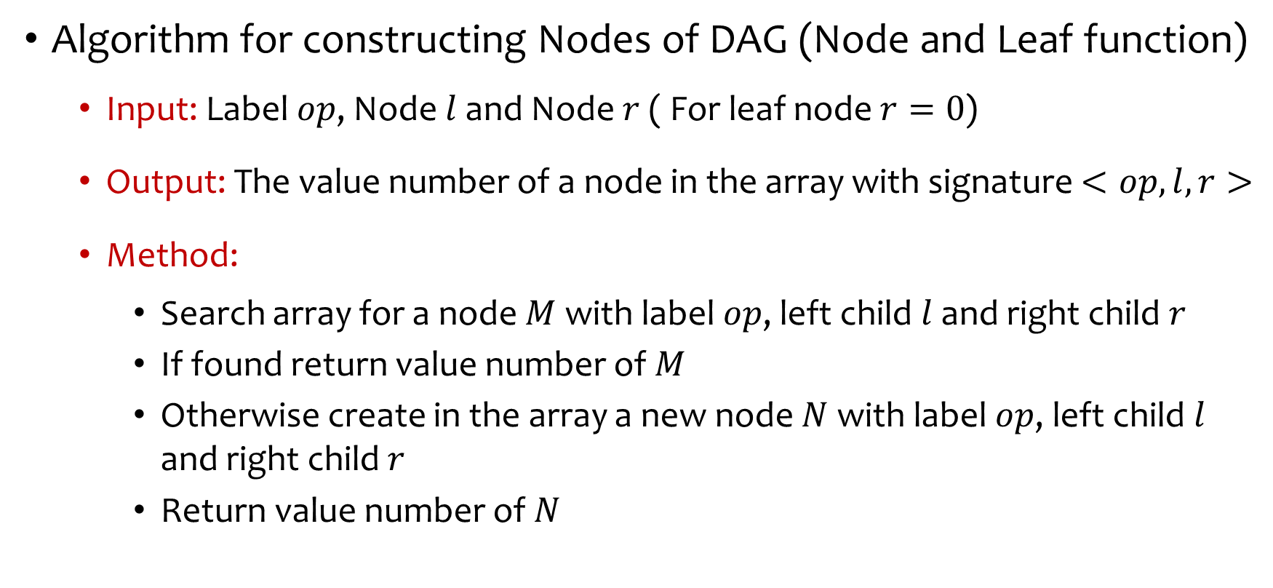
Value Number Method

Slide 20
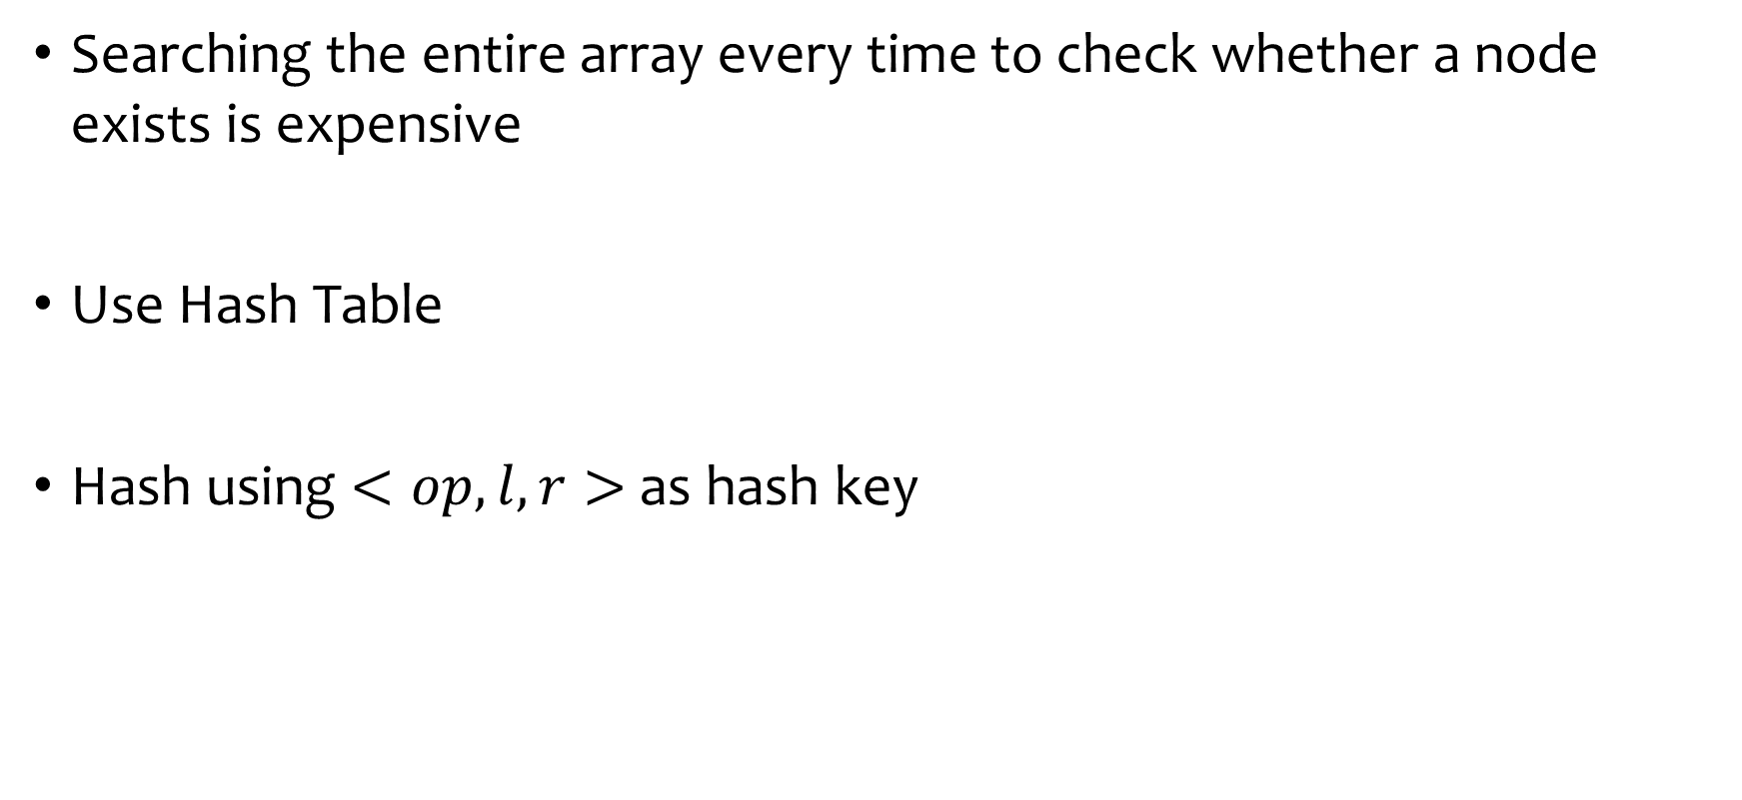
Value Number Method

Slide 21
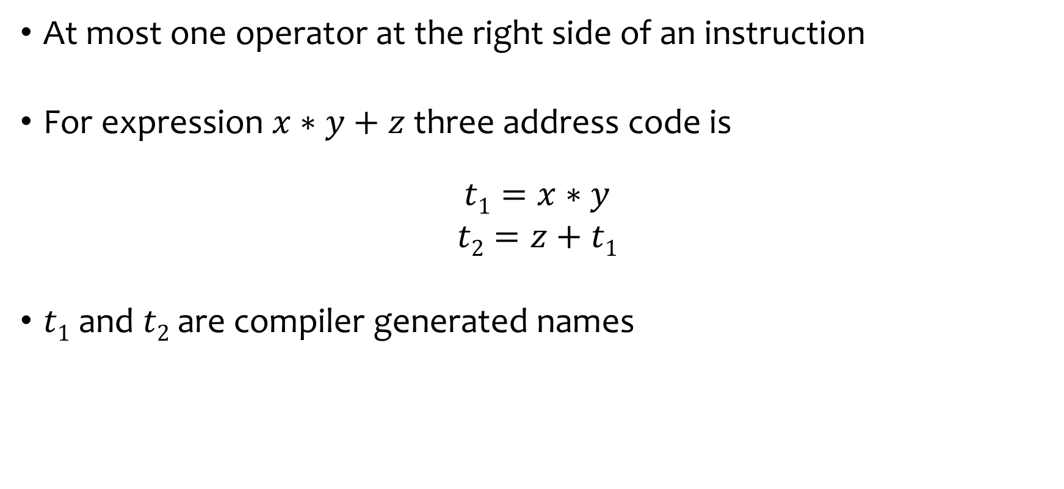
Three Address Code

Slide 22










Three Address Code
Linearized representation for DAG
Explicit name corresponds to the interior nodes
Each instruction in the sequence has a label
Three Address Code

Slide 23
Three Address Code
Based on Two concepts:
Address
What address can be used in the code
Instruction
What kind of instruction sets can be applied

Slide 24
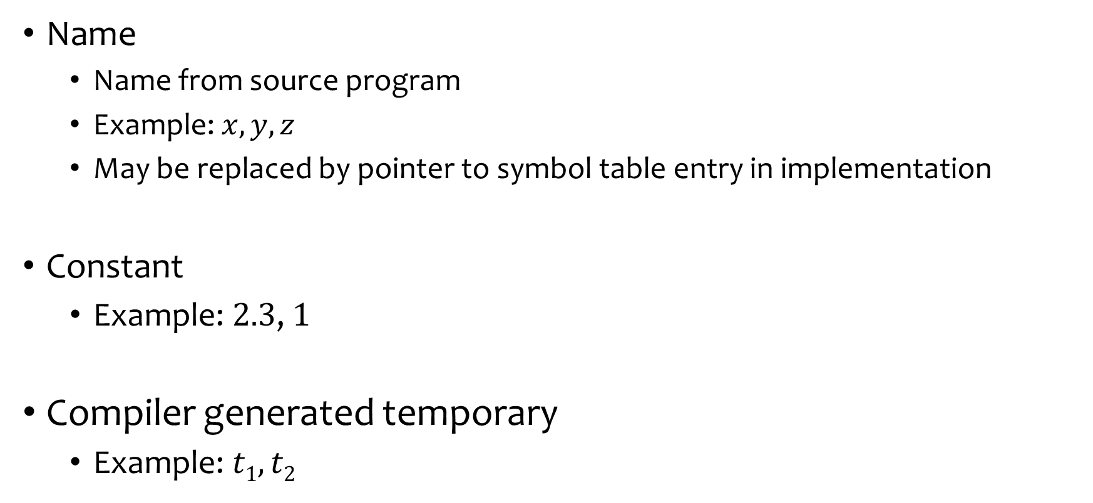
Address

Slide 25
Instructions
Assignment instructions
x = y op z where x, y, z are addresses and op is a binary operator
x = op y where op is a unary operation such as unary minus, logical negation and conversion operator
Copy instruction: x = y
x is assigned the value of y
An unconditional jump : goto L
Instruction with label L is executed next
Conditional jumps:
if x goto L
ifFalse x goto L
if x relop y goto L

Slide 26
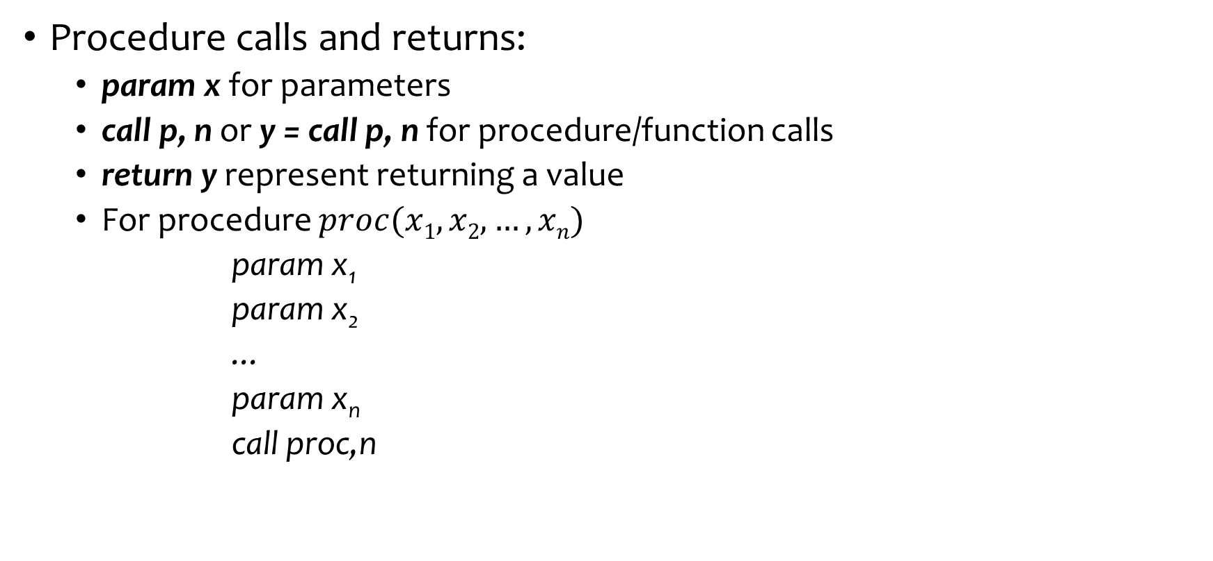
Instructions

Slide 27
Instructions
Indexed copy instructions:
x = y[i] sets x to the value in the location i memory units beyond location y.
x[i] = y sets the contents of the location i units beyond x to the value of y
Address and Pointers assignments:
x = & y
x = * y
* x = y

Slide 28
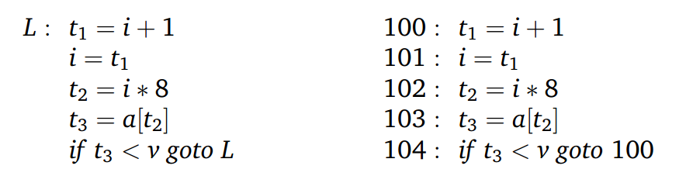
Instructions
Example: do i = i +1; while( a[i] < v );
Symbolic Labels
Position Numbers

Slide 29
Choice of Operators
The choice of allowable operators is an important issue
The operator set clearly must be rich enough to implement the operations in the source language.
Operators that are close to machine instructions make it easier to implement the intermediate form on a target machine.
However, if the front end must generate long sequences of instructions for some source-language operations, then the optimizer and code generator may have to work harder to rediscover the structure and generate good code for these operations.

Slide 30
Representing Three Address Code
What is the suitable data structure to represent three address code?
Can be represented using objects or record with operators and operands as fields
Three representations:
Quadruples
Triples
Indirect Triples

Slide 31
Quadruples
Four Fields:
op – represent operator
arg1, arg2 – holding operands
result – hold result of the operation
Exceptions:
Unary Operators: no arg2
param operator: no arg2, no result
(Un)conditional jump: target label is the result

Slide 32
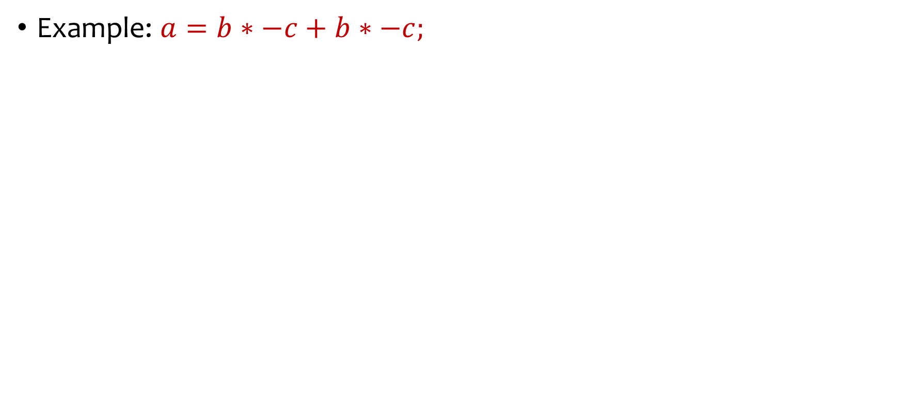
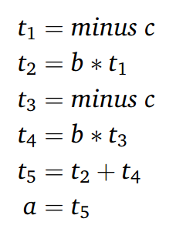
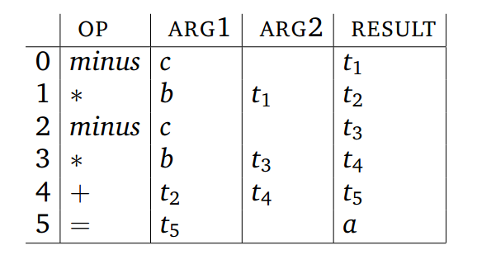
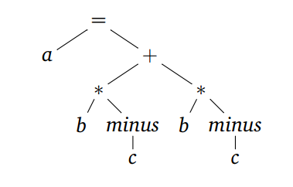
Quadruples
Syntax Tree
Three Address Code
Quadruples

Slide 33
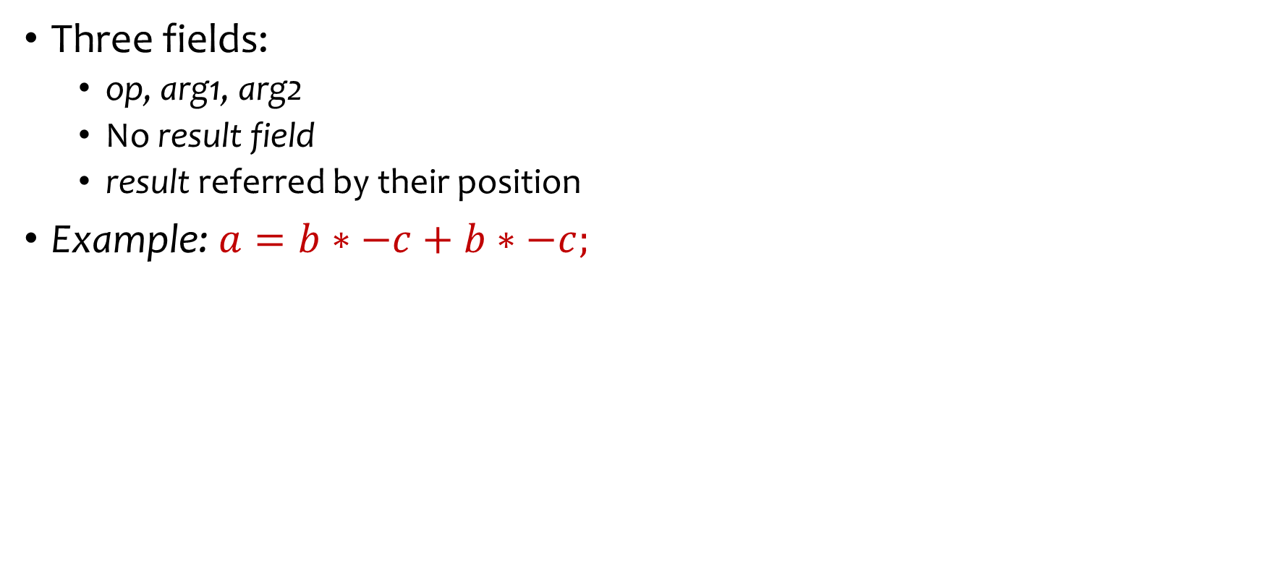
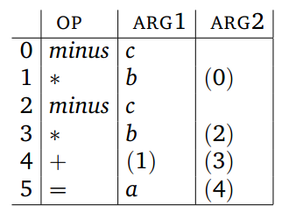
Triples
Syntax Tree
Triples
Three Address Code

Slide 34
Triples
Optimization by moving instructions is difficult in Triples, but easy in Quadruples
Moving instructions forces to adjust the arguments where that position appear
Triples

Slide 35
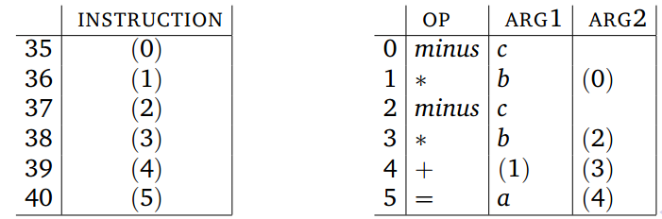
Indirect Triples
Listing pointers to the triples instead of triples
Reorder the pointers instead of the tuples itself during code motion
Triples
Indirect Triples

Slide 36
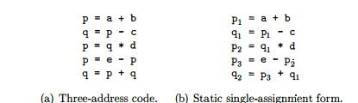
Static Single Assignment Form (SSA)
Another form of IR
All assignments are to variables with distinct names
Facilitates code optimizations
SSA
Assignment to the same variable
Easy to detect and remove
Redundant but difficult to detect
x₁ = 10
x₂ = 15
y = x₂
x = 10
x = 15
y = x
SSA

Slide 37
Static Single Assignment Form (SSA)
Converting ordinary code into SSA form
Replace the target of each assignment with a new variable
Replacing each use of a variable with the "version" of the variable reaching that point.
What to do when branching is involved?
if (flag) x = -1; else x = 1
y = x*a
SSA
if (flag) x₁ = -1; else x₂ = 1
y = x?*a
Φ functions to combine two definitions of the same variable x
if (flag) x₁ = -1; else x₂ = 1
x₃ = ϕ(x_{1,} x₂)
y = x₃*a
if (flag) x = -1; else x = 1
y = x*a
SSA
For further details see: https://en.wikipedia.org/wiki/Static_single-assignment_form

Slide 38
Types and Declarations
Application of types
Type Checking
Uses logical rules to reason about the behavior of a program at run time
Ensures that the types of the operands match the type expected by an operator
Example: the && operator in java expects it two operands to be booleans; the result type is also boolean
Translation Applications
From the type of a name, a compiler can determine its required storage at runtime
Type information is also needed
to calculate the address denoted by an array reference
to insert explicit type conversion
to choose the right version of an arithmetic operator

Slide 39
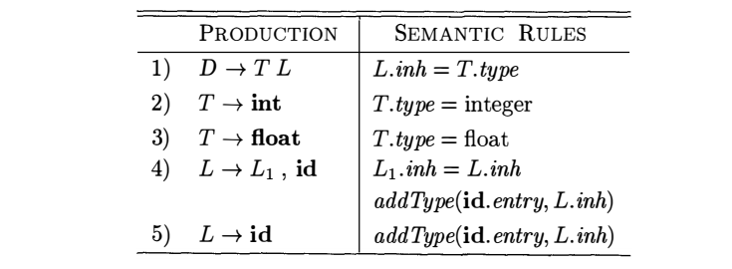
Computing Types
Let us compute an SDD to support declarations like
int id1, id2, id3
float id1, id2, id3
D
L.inh=T.type
T.type=float
T
L₁.inh=L.inh
L
addType(id₃.entry, L.inh)
float
L₂.inh=L₁.inh
L₁
addType(id₂.entry, L₁.inh)
id₃
L₂
addType(id₁.entry, L₂.inh)
id₂
Parse tree for the declaration:
float id1, id2, id3
id₁

Slide 40
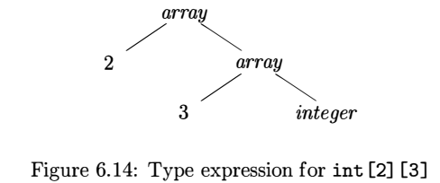
Type Expressions
Type expressions are used to represent structures of types
A type expression is either a basic type or is formed by applying an operator called a type constructor to a type expression
The sets of basic types and constructors depend on the language to be checked
Example: The array type int[2][3] can be
read as “array of two arrays of 3 integers each”
written as a type expression array(2,array(3,integer))
the operator array takes two parameters, a number and a type
Type expressions can be represented using a graph and the value-number method can used to store type expressions.

Slide 41
Definition of Type Expressions
A basic type is a type expression such as boolean, float, char, integer and void
A type name is a type expression such as name of a record, structure or class
A type expression can be formed by applying the array type constructor to a number and a type expression
A record is a data structure with named fields. A type name can be formed by applying the record type constructor to the field names and their types
A type expression can be formed by using the type constructor 🡪 for function types.
s🡪t denotes “function from type s to type t
If s and t are type expressions, then their Cartesian product s x t is a type expression.
Is used to represent a list or tuple of tuples (e.g., for function parameters)
Type expressions may contain variables whose values are type expressions

Slide 42
Type Equivalence
Many type-checking rules have the form, “if two type expressions are equal then return a certain type else error”
When type expressions are represented by graphs, two types are structurally equivalent if and only if one of the following conditions hold
They are the same basic type.
They are formed by applying the same constructor to structurally equivalent types
One is a type name that denotes the other

Slide 43
Storage Layout for Local Names
From the type of a name, the amount of storage required for it during runtime can be determined
At compile time, these amounts can be used to assign each name a relative address
The type and relative address are saved in the symbol-table entry for the name
Data of varying length, such as strings, dynamic arrays is handled by reserving a known fixed amount of storage for a pointer to the data

Slide 44
Storage Layout for Local Names (2)
The width of a type is the number of storage units needed for objects of that type
we consider a byte as the smallest unit of addressable memory
A basic type, such as a character, integer, or float, requires an integral number of bytes
For easy access, storage for aggregates such as arrays and classes is allocated in one contiguous block of bytes

Slide 45
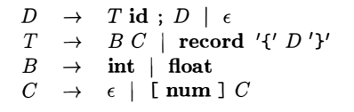
Computing Types and Their Widths
A modified grammar
Supports declarations like
int id; float id;
int[2][3][3] id;
record { int id; int[2][3] id2} id
Let’s start with the productions related to type definition
For the next example we omit the record part

Slide 46
Prod. | Semantic Rules
T 🡪 B C | C.it=B.type, C.iw=B.width T.type=C.type T.width= C.width
B 🡪 int | B.type=float, B.width=4
B 🡪 float | B.type=int, B.width=8
C 🡪 Ɛ | C.type=C.it, C.width= C.iw
C 🡪 [num] C₁ | C₁.it= C.it, C₁.iw= C.iw C.type=array(num.val, C₁.type) C.width= num.val *C₁.width
Annotated Parse tree for int [2][3]
C.it=B.type
C.iw=B.width
T.type=C.type 🡪 array(2, array(3,int))
T.width= C.width 🡪 24
T
C₁.it= C.it
C₁.iw= C.iw
C
C.type=array(num.val, C₁.type) 🡪 array(2, array(3,int))
C.width= num.val *C₁.width 🡪 2*12=24
B
B.type=int
B.width=4
C₂.it=C₁.it
C₂.iw= C₁.iw
C₁.type=array(num.val, C₂.type) 🡪 array(3,int)
C₁.width= num.val *C₂.width 🡪 3*4=12
int
[
num
]
C₁
num.val=2
C₂.type=C₂.it 🡪 int
C₂.width= C₂.iw 🡪 4
[
num
]
C₂
num.val=3
Ɛ

Slide 47
Prod. | Semantic Rules
T 🡪 B C | t=B.type, w=B.width T.type=C.type T.width= C.width
B 🡪 int | B.type=float, B.width=4
B 🡪 float | B.type=int, B.width=8
C 🡪 Ɛ | C.type = t, C.width = w
C 🡪 [num] C₁ | C.type=array(num.val, C₁.type) C.width= num.val *C₁.width
Annotated Parse tree for int [2][3]
C.it t = B.type
C.iw w = B.width
C.it = B.type
C.iw = B.width
T.type=C.type 🡪 array(2, array(3,int))
T.width= C.width 🡪 24
T
C₁.it= C.it
C₁.iw= C.iw
C
C.type=array(num.val, C₁.type) 🡪 array(2, array(3,int))
C.width= num.val *C₁.width 🡪 2*12=24
B
B.type=int
B.width=4
C₂.it=C₁.it
C₂.iw= C₁.iw
C₁.type=array(num.val, C₂.type) 🡪 array(3,int)
C₁.width= num.val *C₂.width 🡪 3*4=12
int
[
num
]
C₁
num.val=2
C₂.type = t C₂.it 🡪 int
C₂.width = w C₂.iw 🡪 4
C₂.type=C₂.it 🡪 int
C₂.width= C₂.iw 🡪 4
[
num
]
C₂
num.val=3
Ɛ
Use of global variables instead of inherited attributes

Slide 48
SDT for Computing Type and Width
T 🡪 B C | { t =B.type, w=B.width } { T.type=C.type T.width= C.width }
B 🡪 int | { B.type=float, B.width=4 }
B 🡪 float | { B.type=int, B.width=8 }
C 🡪 Ɛ | { C.type = t, C.width = w }
C 🡪 [num] C₁ | { C.type=array(num.val, C₁.type) C.width= num.val *C₁.width }
Prod. | Semantic Rules
T 🡪 B C | t=B.type, w=B.width T.type=C.type T.width= C.width
B 🡪 int | B.type=float, B.width=4
B 🡪 float | B.type=int, B.width=8
C 🡪 Ɛ | C.type = t, C.width = w
C 🡪 [num] C₁ | C.type=array(num.val, C₁.type) C.width= num.val *C₁.width
t = B.type
w = B.width
T.type=C.type 🡪 array(2, array(3,int))
T.width= C.width 🡪 24
T
C
C.type=array(num.val, C₁.type) 🡪 array(2, array(3,int))
C.width= num.val *C₁.width 🡪 2*12=24
B
B.type=int
B.width=4
C₁
C₁.type=array(num.val, C₂.type) 🡪 array(3,int)
C₁.width= num.val *C₂.width 🡪 3*4=12
int
[
num
]
num.val=2
[
num
]
C₂
C₂.type = t 🡪 int
C₂.width = w 🡪 4
num.val=3
Annotated Parse tree for int [2][3]
Ɛ

Slide 49
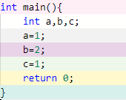
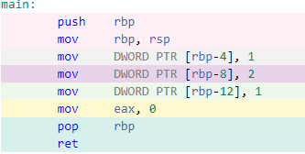

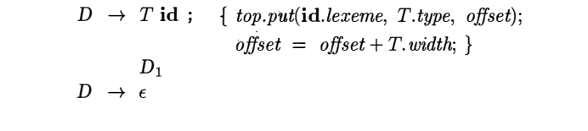
Computing Relative Addresses
CPP
ASM (x86-64 gcc 11.1)
SDT for computing relative addresses

Slide 50
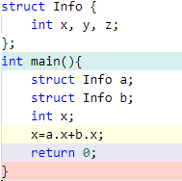
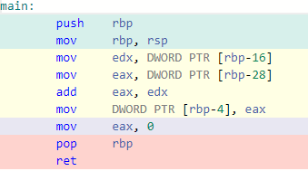

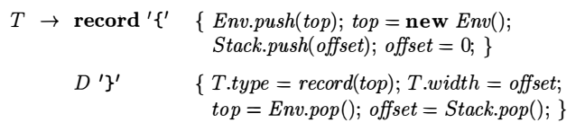
Fields in Records and Classes
CPP
ASM (x86-64 gcc 11.1)
type constructor
symbol table object
Handling of field names in records

Slide 51
Three Address Code Generation

Slide 52
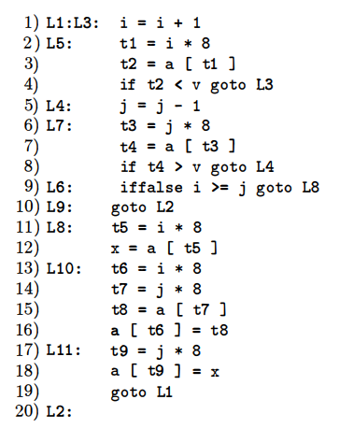
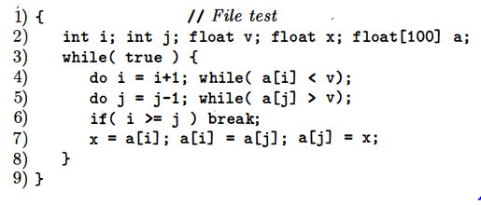
An Example

Slide 53
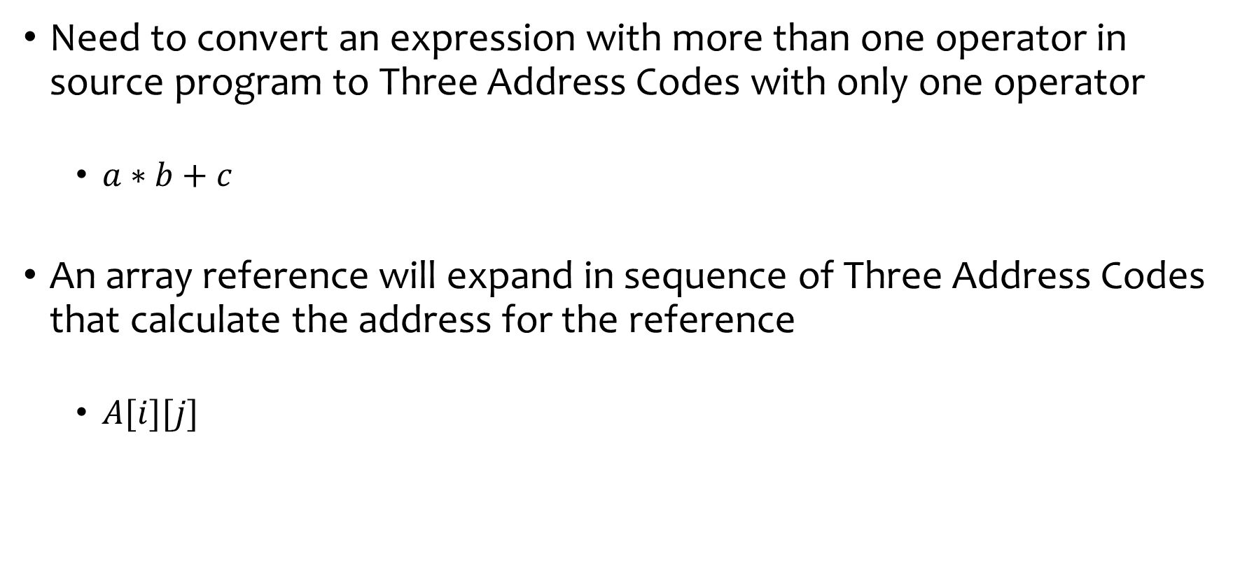
Translation of Expressions

Slide 54

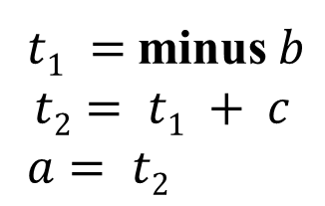
Translation of Expressions
:=
We want to generate the
following code
a
+
t₂
t₁
-
c
b

Slide 55
Construct syntax tree for: a-4+c
E
E.node = new Node (‘+’, E₁.node, T.node)
E.node = new Node (‘-’, E₁.node, T.node)
E
+
T
T.node = new Leaf (id, id.entry)
c
id
E.node = T.node
E
-
T
T.node = new Leaf (num, num.val)
4
T
num
T.node = new Leaf (id, id.entry)
a
id
+
Production
E 🡪 E₁ + T
-
id
E 🡪 E₁ - T
to entry for c
E 🡪 T
T 🡪 ( E )
num
4
id
T 🡪 id
T 🡪 num
to entry for a

Slide 56
AST for a-4+c
AST for w=a-4+c
=
+
w
+
-
c
-
c
a
4
a
4
Prod. | Semantic Rules
E 🡪 E₁ + T | E.node = new Node (‘+’, E₁.node, T.node)
E 🡪 E₁ – T | E.node = new Node (‘-’, E₁.node, T.node)
E 🡪 T | E.node = T.node
T 🡪 (E) | E.node = E.node
T 🡪 id | T.node = new Leaf (id, id.entry)
T 🡪 num | T.node = new Leaf (num, num.val)
Prod. | Semantic Rules
S 🡪 id = E | S.node = new Node (‘:=‘, new Leaf (id, id.entry), E.node)
E 🡪 E₁ + T | E.node = new Node (‘+’, E₁.node, T.node)
E 🡪 E₁ – T | E.node = new Node (‘-’, E₁.node, T.node)
E 🡪 T | E.node = T.node
T 🡪 (E) | E.node = E.node
T 🡪 id | T.node = new Leaf (id, id.entry)
T 🡪 num | T.node = new Leaf (num, num.val)

Slide 57
AST for w:=a-b+c
Three address code for w:=a-4+c
=
t1 = a - b
+
t2
w
t2 = t1 + c
-
t1
w = t2
c
a
b
Prod. | Semantic Rules for AST
S 🡪 id = E | S.node = new Node (‘:=‘, new Leaf (id, id.entry), E.node)
E 🡪 E₁ + T | E.node = new Node (‘+’, E₁.node, T.node)
E 🡪 E₁ – T | E.node = new Node (‘-’, E₁.node, T.node)
E 🡪 T | E.node = T.node
T 🡪 (E) | T.node = E.node
T 🡪 id | T.node = new Leaf (id, id.entry)
Prod. | Semantic Rules Three Address Code
S 🡪 id = E | S.code = top.get(id.lexeme) || ‘=‘ || E.addr
E 🡪 E₁ + T | E.addr = new Temp() E.code = E.addr || ‘=‘ || E₁.addr || ‘+’ || T.addr
E 🡪 E₁ – T | E.addr = new Temp() E.code = E.addr || ‘=‘ || E₁.addr || ‘-’ || T.addr
E 🡪 T | E.code =‘’, E.addr = T.addr
T 🡪 (E) | T.code =‘’, T.addr = E.addr
T 🡪 id | T.code =‘’, T.addr = top.get(id.lexeme)
Returns a pointer to symbol table of id

Slide 58
Three address code for w:=a-b+c
Prod. | Semantic Rules Three Address Code
S 🡪 id = E | S.code = top.get(id.lexeme) || ‘=‘ || E.addr
E 🡪 E₁ + T | E.addr = new Temp() E.code = E.addr || ‘=‘ || E₁.addr || ‘+’ || T.addr
E 🡪 E₁ – T | E.addr = new Temp() E.code = E.addr || ‘=‘ || E₁.addr || ‘-’ || T.addr
E 🡪 T | E.code =‘’, E.addr = T.addr
T 🡪 (E) | T.code =‘’, T.addr = E.addr
T 🡪 id | T.code =‘’, T.addr = top.get(id.lexeme)
But S.code produces a single line!
S.code = top.get(id.lexeme) || ‘=‘ || E.addr
🡪 w= t2
S
E.addr = new Temp() 🡪 t2
E.code = E.addr || ‘=‘ ||
E₁.addr || ‘+’ || T.addr
🡪 t2= t1 + c
id
=
E
E₁.addr = new Temp() 🡪 t1
E₁.code = E₁.addr || ‘=‘ ||
E₂.addr || ‘-’ || T.addr
🡪 t1= a -b
T
T.code =‘’
T.addr = top.get(id.lexeme) 🡪 c
E₁
+
id
₋
E₂
E.code =‘’
E.addr = T.addr 🡪 a
T
T.code =‘’
T.addr = top.get(id.lexeme) 🡪 b
id
t1 = a - b
T
T.code =‘’
T.addr = top.get(id.lexeme) 🡪 a
w:=a-b+c
t2 = t1 + c
w = t2
id

Slide 59
Three address code for w:=a-b+c
Prod. | Semantic Rules Three Address Code
S 🡪 id = E | S.code = E.code|| top.get(id.lexeme) || ‘=‘ || E.addr
E 🡪 E₁ + T | E.addr = new Temp() E.code = E₁.code || T.code || E.addr || ‘=‘ || E₁.addr || ‘+’ || T.addr
E 🡪 E₁ – T | E.addr = new Temp() E.code = E₁.code || T.code || E.addr || ‘=‘ || E₁.addr || ‘-’ || T.addr
E 🡪 T | E.code =T.code, E.addr = T.addr
T 🡪 (E) | T.code =E.code, T.addr = E.addr
T 🡪 id | T.code =‘’, T.addr = top.get(id.lexeme)
S.code = E.code ||
top.get(id.lexeme) || ‘=‘ || E.addr
t1= a –b
t2= t1 + c
w= t2
E.addr = new Temp() 🡪 t2
E.code = E₁.code || T.code ||
E.addr || ‘=‘ || E₁.addr || ‘+’ || T.addr
🡪 t1= a –b
t2= t1 + c
S
id
:=
E
E₁.addr = new Temp() 🡪 t1
E₁.code = E₁.code || T.code || E₁.addr || ‘=‘ || E₂.addr || ‘-’ || T.addr
🡪 t1= a -b
E₁
+
T
T.code =‘’
T.addr = top.get(id.lexeme) 🡪 c
id
₋
E₂
E.code =T.code
E.addr = T.addr 🡪 a
T
T.code =‘’
T.addr = top.get(id.lexeme) 🡪 b
t1 = a - b
id
w:=a-b+c
t2 = t1 + c
T
T.code =‘’
T.addr = top.get(id.lexeme) 🡪 a
w = t2
id

Slide 60
Three address code for w:=a-b+c
Prod. | Semantic Rules Three Address Code
S 🡪 id = E | print (top.get(id.lexeme) || ‘=‘ || E.addr)
E 🡪 E₁ + T | E.addr = new Temp() print (E.addr || ‘=‘ || E₁.addr || ‘+’ || T.addr)
E 🡪 E₁ – T | E.addr = new Temp() print (E.addr || ‘=‘ || E₁.addr || ‘-’ || T.addr)
E 🡪 T | E.addr = T.addr
T 🡪 (E) | T.addr = E.addr
T 🡪 id | T.addr = top.get(id.lexeme)
print (top.get(id.lexeme) || ‘=‘ || E.addr)
w= t2
S
E.addr = new Temp() 🡪 t2
print (E.addr || ‘=‘ || E₁.addr || ‘+’
|| T.addr)
🡪 t2= t1 + c
id
:=
E
E₁.addr = new Temp() 🡪 t1
print (E₁.addr || ‘=‘ || E₂.addr || ‘-’ || T.addr)
🡪 t1= a -b
E₁
+
T
T.addr = top.get(id.lexeme) 🡪 c
id
₋
E₂
E.addr = T.addr 🡪 a
T
T.addr = top.get(id.lexeme) 🡪 b
id
T
On the Fly (Incremental) Code Generation
t1 = a - b
T.addr = top.get(id.lexeme) 🡪 a
w:=a-b+c
t2 = t1 + c
id
w = t2

Slide 61
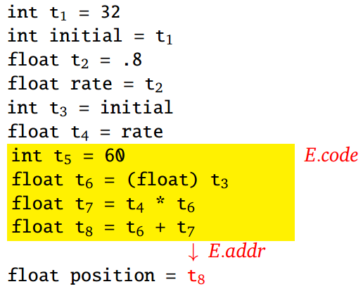
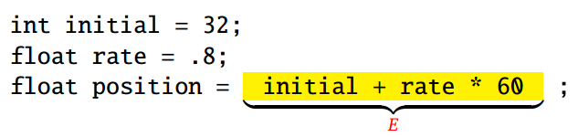
Translation of Expressions
A Source C code
Corresponding Three Address Code

Slide 62
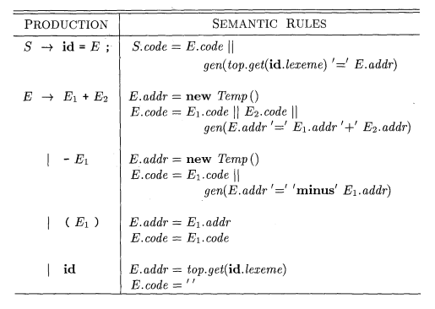
Translation of Expressions
A different CFG and SDD from your text
gen(…) builds an instruction and returns it

Slide 63


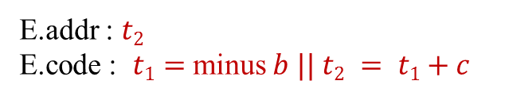

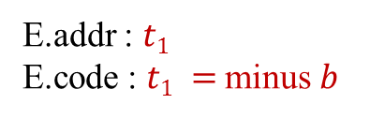
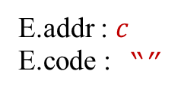
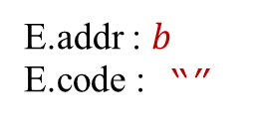
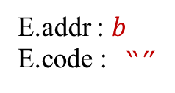


Translation of Expressions
S
id
:=
E
E
+
E
-
E
(
)
E
id
id

Slide 64
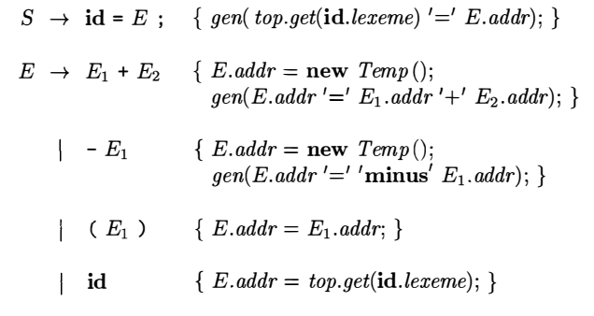
Incremental Translation
Code attributes can be long strings, so they are usually generated incrementally
Instead of building up E.code, generate only the new three address instructions
The function gen(…), in addition to constructing new instruction, append to the stream
Generating three-address code for expressions incrementally

Slide 65
Addressing Array Element
In C and Java, array elements are numbered 0,1,….,n-1, for an array of n elements
If the width of each array element is w, then the i-th element of array A begins in location
The above formula generalized to k-dimensions as
For the array, int A[5][7][8], location of A[2][3][4] will be
base + i x w
Here base is the relative address of A[0]
base + i₁ x w₁ + i₂ x w₂ + …+ i_{k} x w_{k}
base + 2 x 224 + 3 X 32 + 4 x 4
Here size of integer is assumed as 4 byte

Slide 66
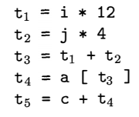


Translation of Array References
The chief problem in generating code for array references is to related the address calculation formulas to a grammar for array references
For the array a declared as int[2][3], three-address translation of the expression –
We will use the following grammar production rule where nonterminal L generates an array name followed by a sequence of index expression.

Slide 67
Translation of array references for c+a[i][j]
Prod.
S 🡪 id = E
S 🡪 L = E
E 🡪 E₁ + E₂
E 🡪 id
E 🡪 L
L 🡪 id [E]
L 🡪 L₁ [E]
E.addr = new Temp ()
gen (E.addr || ‘=‘ || E₁.addr || ‘+’ || E₂.addr
E
E₂.addr = new Temp ()
gen (E₂.addr || ‘=‘ || L.array.base || ‘[‘ || L.addr || ‘]’
+
E₂
E₁
E₁.addr = top.get(id.lexeme)
c
L.array = L₁.array
L.type = L₁. type.elem
t = new Temp ()
L.addr = new Temp()
gen (t || ‘=‘ || E.addr || ‘*‘ || L.type.width
gen (L.addr || ‘=‘ || L1.addr || ‘+’ || t
id
L
L₁.array = top.get(id.lexeme)
L₁.type = L₁.array.type.elem
L₁.addr = new Temp()
gen (L₁.addr || ‘=‘ || E.addr || ‘*‘ || L₁.type.width
]
L₁
[
E
E.addr = top.get(id.lexeme)
j
a
id
[
E
]
id
i
E.addr = top.get(id.lexeme)
id

Slide 68
SDT for Computing Type and Width
P 🡪 D | {offset = 0;}
D 🡪 T id | { top.put(id.lexeme, T.type, offset; offset = offset + T.width}
T 🡪 B C | { t =B.type, w=B.width } { T.type=C.type T.width= C.width }
B 🡪 int | { B.type=float, B.width=4 }
B 🡪 float | { B.type=int, B.width=8 }
C 🡪 Ɛ | { C.type = t, C.width = w }
C 🡪 [num] C₁ | { C.type=array(num.val, C₁.type) C.width= num.val *C₁.width }
Annotated Parse tree for int [2][3] a
P
top.put(id.lexeme, T.type, offset;
offset = offset + T.width
D
a
id
t = B.type
w = B.width
T.type=C.type 🡪 array(2, array(3,int))
T.width= C.width 🡪 24
T
B
C
C.type=array(num.val, C₁.type) 🡪 array(2, array(3,int))
C.width= num.val *C₁.width 🡪 2*12=24
B.type=int
B.width=4
C₁
C₁.type=array(num.val, C₂.type) 🡪 array(3,int)
C₁.width= num.val *C₂.width 🡪 3*4=12
int
[
num
]
num.val=2
Type expression for int[2][3]
[
num
]
C₂
C₂.type = t 🡪 int
C₂.width = w 🡪 4
num.val=3
Ɛ

Slide 69
Annotated Parse tree for int [2][3] a
P
Symbol Info
Token | ID
Base | a
Type
top.put(id.lexeme, T.type, offset;
offset = offset + T.width
D
Type
Token | Array
Width | 24
Size | 2
Elem
a
id
t = B.type
w = B.width
T.type=C.type 🡪 array(2, array(3,int))
T.width= C.width 🡪 24
T
B
C
C.type=array(num.val, C₁.type) 🡪 array(2, array(3,int))
C.width= num.val *C₁.width 🡪 2*12=24
Type
Token | Array
Width | 12
Size | 3
Elem
B.type=int
B.width=4
C₁
C₁.type=array(num.val, C₂.type) 🡪 array(3,int)
C₁.width= num.val *C₂.width 🡪 3*4=12
int
[
num
]
num.val=2
Type
Token | Int
Width | 4
[
num
]
C₂
C₂.type = t 🡪 int
C₂.width = w 🡪 4
num.val=3
Ɛ

Slide 70
Translation of array references for c+a[i][j]
Symbol Info
Token | ID
Base | a
Type
E.addr = new Temp () 🡪 t5
gen (E.addr || ‘=‘ || E₁.addr || ‘+’ || E₂.addr
🡪 t5 = c + t4
E
E₂.addr = new Temp () 🡪 t4
gen (E₂.addr || ‘=‘ || L.array.base || ‘[‘ || L.addr || ‘]’
🡪 t4 = a [t3]
+
E₂
Type
Token | Array
Width | 24
Size | 2
Elem
E₁
E₁.addr = top.get(id.lexeme) 🡪 c
L.array = L₁.array 🡪 a
L.type = L₁. type.elem
t = new Temp () 🡪 t2
L.addr = new Temp() 🡪 t3
gen (t || ‘=‘ || E.addr || ‘*‘ || L.type.width
gen (L.addr || ‘=‘ || L₁.addr || ‘+’ || t
🡪 t2 = j* 4
t3 = t1 + t2
c
id
L
L₁.array = top.get(id.lexeme) 🡪 a
L₁.type = L.array.type.elem
L₁.addr = new Temp() 🡪 t1
gen (L.addr || ‘=‘ || E.addr || ‘*‘ || L₁.type.width
🡪 t1 = i * 12
]
Type
Token | Array
Width | 12
Size | 3
Elem
L₁
[
E
E.addr = top.get(id.lexeme) 🡪 j
j
a
id
[
E
]
id
i
E.addr = top.get(id.lexeme) 🡪 i
Type
Token | Int
Width | 4
id

Slide 71
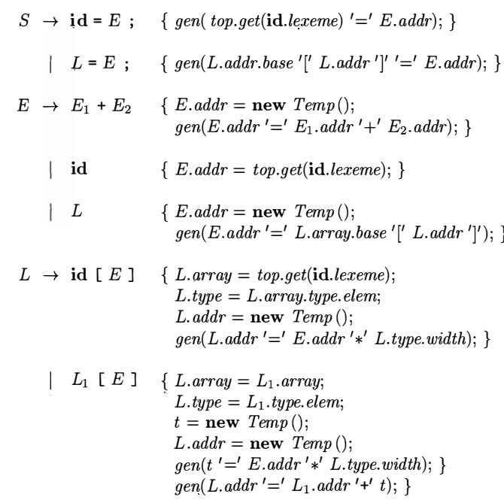
Translation of Array References (2)
Attributes of L
L.addr - a temporary that holds the sum of the terms i_{k} x w_{k}
L.array - a pointer to the symbol-table entry for the array name
L.type - type of the subarray generated by L

Slide 72
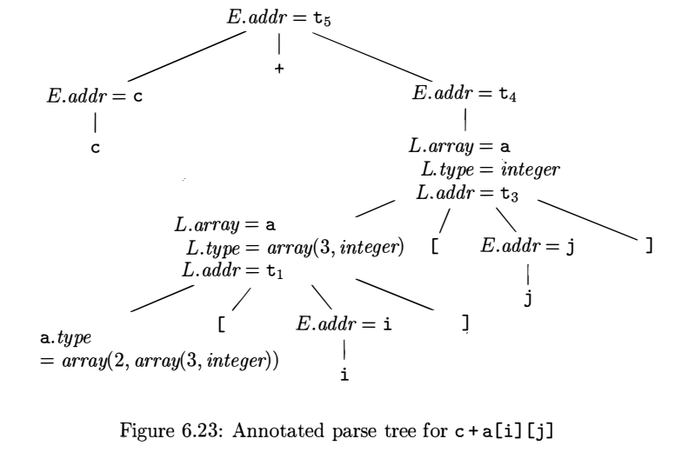
Translation of Array References (2)

Slide 73
Control Flow
We will translate control flow statements such as if-else, while
Translation of control flow statements are tied with Boolean expressions
Boolean expression composed of Boolean operators
Boolean operator are applied to
Boolean variables
Relational expression with relational operator

Slide 74
Boolean Expression
We consider Boolean Expression generated by following grammar
rel is relational operator which is any one of < , > , <= , >= , ==, !=
We assume &&, || are left associative and precedence order if !, && then ||

Slide 75
Boolean Expression
Boolean expressions are used to
Alter flow of control
If (E) the S: E must be true to reach S
To compute logical values
True or False as value

Slide 76
Short Circuit Code
Also called jumping code
&&, || and ! are translated into jumps
The operators don’t appear in the code
The value of a boolean expression is represented by a position in the code

Slide 77
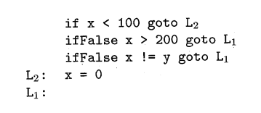
Short Circuit Code
Example:
A statement with Boolean expression
Jumping Code

Slide 78


Flow of Control Statements

Slide 79
Flow of Control Statements
The Grammar
Productions | Semantic Rules
assign is a Placeholder for
an assignment statement
We need to find out the Semantic Rules

Slide 80



Flow of Control Statements
S.code
to B.true
B.code
Productions | Semantic Rules
to B.false
B.true:
S1.code
to S1.next
S1.next:
B.false:
S.next:
… … …

Slide 81
Flow of Control Statements
Semantic Rules for the first two productions
S.code
Productions | Semantic Rules
S.next:
S1.code
S1.next:
S2.code
S2.next:
… … …

Slide 82
Flow of Control Statements
Attributes of SDD that will translate this grammar:
Codes are managed using
B.code : contains codes of B
S.code : contains codes of S
Jumping Labels are managed using
B.true : label to which control flows if B is true
B.false : label to which control flows if B is false
S.next : label of a instruction immediately after S
Synthesized
Inherited

Slide 83
Flow of Control Statements
Productions | Semantic Rules
S.code
to B.true
B.code
to B.false
B.true:
S1.code
to S1.next
go to S1.next
B.false:
S2.code
to S2.next
S2.next:
S1.next:
S.next:
… … …

Slide 84
Flow of Control Statements
Productions | Semantic Rules
S.code
begin:
S1.next:
to B.true
B.code
to B.false
B.true:
S1.code
to S1.next
go to begin
B.false:
S.next:
… … …

Slide 85


Translation of Boolean Expression
How to produce B.code?

Slide 86
Translation of Boolean Expression
The Grammar
Productions | Semantic Rules

Slide 87

Translation of Boolean Expression

Slide 88


Translation of Boolean Expression
to B.true
B.code
to B.false
B.true:
… …. …
B.false:
… … …

Slide 89
Translation of Boolean Expression
B.code
to B1.true
B1.code
to B1.false
B1.false:
to B2.true
B2.code
to B2.false
B2.true:
B1.true:
B.true:
… …. …
B2.false:
B.false:
S.next:
… … …

Slide 90


Translation of Boolean Expression

Slide 91


Translation of Boolean Expression

Slide 92


Translation of Boolean Expression

Slide 93


Translation of Boolean Expression

Slide 94

SDD for Generating Three Address Code for Flow-of-Control Statements

Slide 95

SDD for Generating Three Address Code for Booleans

Slide 96
Translation of statement
P
if ( x-k < 100 || x-k > 200 && x != y )
x = 0;
y = x + 10;
if ( x-k < 100 || x-k > 200 && x != y )
x = 0;
S
y = x + 10
Prod.
P 🡪 S
S 🡪 id = E;
S 🡪 S₁ S₂
S 🡪 if (B) S₁
B 🡪 B₁ || B₂
B 🡪 B₁ && B₂
B 🡪 E₁ rel E₂
E 🡪 …
S₁
S₂
y
x + 10
x-k < 100 || x-k > 200 && x != y
x = 0
id
=
E₇
if
(
B
)
S₃
0
…
x
id
=
E₇
x-k < 100
x-k > 200 && x != y
B₁
||
B₂
…
x-k
100
x-k > 200
x != y
<
E₁
rel
E₂
B₃
B₄
&&
…
…
x
y
x-k
>
200
!=
E₃
rel
E₄
E₅
rel
E₆
…
…
…
…

Slide 97
t1 = x-k
t2=100
if t1 < t2 go to B1.true go to B1.false
t3 = x-k
t4=200
if t3 < t4 go to B3.true go to B3.false
if x != y go to B4.true go to B4.false
x = t5
t6 = x+10
y = t6
Translation of statement
E1
P
P.code: ‘’
E2
if ( x-k < 100 || x-k > 200 && x != y )
x = 0;
y = x + 10;
B1
L2
S
S2.code: ‘’
L3
S1.next=new Label() 🡪 L1
L3:
E3
B
B.true=new Label() 🡪 L2
B.false=S1.next 🡪 L1
S3.next=S1.next 🡪 L1
{print(S1.next)}
S2.code: id.lexeme=E8.addr
S1
E4
S₁
S1.Code: ‘’
S₂
B3
y
x + 10
L4
B2
S3.code: id.lexeme=E7.addr
L1
B1.true=B.true 🡪 L2
B1.false=new Label() 🡪 L3
B2.true=B.true 🡪 L2
B2.false=B.false 🡪 L1
L4:
L2
if
(
S₃
id
=
E₈
B4
B
)
{print(B.true)}
L1
B.Code: ‘’
E8.code: t6 = x+10
E1.Addr: t6
L2:
0
…
S3
x
L1:
B1.Code:
if E1.addr rel E2.addr
go to B1.true
go to B1.false
S2
B3.true=new Label() 🡪 L4
B3.false=B2.false 🡪 L1
B4.true=B2.true 🡪 L2
B4.false=B2.false 🡪 L1
id
=
E₇
E7.code: t5=0
E5.Addr: t5
B₁
||
{print(B1.false)}
…
B₂
B2.Code: ‘’
x-k
<
100
B3.Code:
if E3.addr rel E4.addr
go to B3.true
go to B3.false
E1.code: t1 = x-k
E1.Addr: t1
E2.code: t2=100
E2.Addr: t2
B4.Code:
if E5.addr rel E6.addr
go to B4.true
go to B4.false
E₁
rel
E₂
B₃
{print(B3.true)}
B₄
&&
…
…
x-k
>
200
x
y
!=
E1.code: ‘’
E5.Addr: y
E1.code: ‘’
E5.Addr: x
E3.code: t3 = x-k
E3.Addr: t3
E2.code: t4=200
E2.Addr: t4
E₅
rel
E₆
E₃
rel
E₄
…
…
…
…

Slide 98

Avoiding Redundant Gotos

Slide 99



Avoiding Redundant Gotos
Self Study

Slide 100



Avoiding Redundant Gotos
Self Study

Slide 101



Avoiding Redundant Gotos
Self Study

Slide 102

Boolean Values and Jumping Code
So far we have use boolean expressions to alter the flow of control in statements
A boolean expression may also be evaluated for its value such as
if ( a < b && c < d )
x=true;
else x=false;

Slide 103
Boolean Values and Jumping Code
A clean way of handling both roles of boolean expressions is to first build a syntax tree for expressions, using either of the following approaches
Use two passes
– Construct a complete syntax tree for the input, and
– then traverse in depth-first order computing the translations specified by the semantic rule
Use one pass for statements, but two passes for expressions
– In the approach, we would first translate E in while (E) S1 before S1 is examined.
– The translation of E, however would be done by building its syntax tree and then walking the tree
Use separate code generation functions for expressions
One for generating jumping code
The other for computing the value
Self Study

Slide 104
Backpatching
A key problem when generating code for boolean expression and flow-of-control statement is that of matching a jump instruction with the target of the jump
The SDD we have used earlier generates symbolic labels
A separate pass is needed to bind labels to address
1st Pass
2nd Pass
100:
106
101:
102
102:
104
103:
107
104:
106
105:
107
106:
107:

Slide 105
Backpatching
Backpatching is used to generate code for boolean expressions and flow-of-control statements in one pass
In Backpatching, list of jumps are passed as synthesized attributes
Specifically, when a jump is generated, the target of the jump label is left unspecified
Each such jump is put on a list of jumps whose labels are to be filled in when proper label can be determined
All of the jumps on a list have the same target label

Slide 106
Code Generation Using Backpatching
Two synthesized attributes for boolean expression B
B. truelist – a list of jumps or conditional jumps into which we must insert the label to which control goes if B is true
B. falselist – a list of jumps or conditional jumps into which we must insert the label to which control goes if B is false
A synthesized attribute for statement S
S. nextlist – a list of jumps to the instruction immediately following the code for S
Three functions
makelist(i) – creates a new list containing only I, an index into the array of instructions. Returns a pointer to the newly created array
merge(p1, p2) – concatenates the lists pointed to by p1 and p2, and returns a pointer to the concatenated list
backpatch(p, i) – inserts i as the target label for each of the instructions on the list pointed to by p

Slide 107
Code Generation
SDD for Flow-of-Control and Booleans (partial)
SDT for Flow-of-Control and Booleans (on the fly)
Production | Semantic Action |  | Productions with Embedded Actions
L 🡪 L₁ S | L₁.next=newlabel() S.next=L. next L.code=L₁.code || label(L₁.next) || S.code |  | L 🡪 { L₁.next=newlabel(); } L₁ { S.next=L. next; label(L₁.next); } S
L 🡪 S | L.code=S.code |  | L 🡪 { S.next=L. next; } S
S 🡪 if (B) S₁ | B.true=newlabel() B. false=S₁.next=S. next S.code=B.code || label(B.true) || S₁.code |  | S 🡪 if ( { B.true=newlabel(); B. false=S₁.next=S. next; } B) { label(B.true);} S₁
B 🡪 B₁ || B₂ | B₁.true=B.true B₁. false=newlabel() B₂.true=B.true B₂. false=B.false B.code=B₁.code || label(B₁.false) || B₂.code |  | B 🡪 { B₁.true=B.true; B₁. false=newlabel(); } B₁ || { B₂.true=B.true; B₂. false=B.false; label(B₁. false); } B₂
B 🡪 E₁ rel E₂ | B.code=E₁.code || E₂.code || gen(‘if’ E₁.addr rel E₂.addr ‘ goto B.true’) || gen(‘ goto B.false’) |  | B 🡪 E₁ rel E₂ { gen(‘if’ E₁.addr rel E₂.addr ‘ goto B.true’); gen(‘ goto B.false’); }

Slide 108
Code Generation Using Backpatching
SDT for Flow-of-Control and Booleans (on the fly) | SDT for Backpatching
L 🡪 { L₁.next=newlabel(); } L₁ {S.next=L. next; label(L₁.next); } S | L 🡪 L₁ M S | { Backpatch(L₁.nextlist, M.instr); } L.nextlist=S.nextlist; }
L 🡪 { S.next=L. next; } S | L 🡪 S | { L.nextlist=S.nextlist; }
S 🡪 if ( { B.true=newlabel(); B. false=S₁.next=S. next; } B) { label(B.true);} S₁ | S 🡪 if (B) M S₁ | { S.nextlist=merge(B.falselist, S₁.nextlist); Backpatch(B.truelist, M.instr); }
B 🡪 { B₁.true=B.true; B₁. false=newlabel(); } B₁ || { B₂.true=B.true; B₂. false=B.false; label(B₁. false); } B₂ | B 🡪 B₁ || M B₂ | { B.truelist=merge(B₁.truelist, B₂.truelist); B.falselist=merge(B₂.falselist); Backpatch(B₁.falselist, M.instr); }
B 🡪 E₁ rel E₂ { gen(‘if’ E₁.addr rel E₂.addr ‘ goto B.true’); gen(‘ goto B.false’); } | B 🡪 E₁ rel E₂ | { B.truelist=makelist(nextinstr); B.falselist=makelist(nextinstr+1); gen(‘if’ E₁.addr rel E₂.addr ‘ goto __’); gen(‘ goto __’); }
 | M 🡪 Ɛ | { M.instr=nextinstr; }

Slide 109

Backpatching for Boolean Expression

Slide 110
Translation of a boolean expression using backpatching
x < 100 || x > 200 && x != y
B
Prod
B 🡪 B₁ && B₂
B 🡪 B₁ || B₂
B 🡪 E₁ rel E₂
x < 100
x > 200 && x != y
B₁
||
B₂
x
100
x > 200
x != y
<
E₁
rel
E₂
B₃
B₄
&&
…
…
x
y
x
>
200
!=
E₃
rel
E₄
E₅
rel
E₆
…
…
…
…

Slide 111
Translation of a boolean expression using backpatching
B.truelist={100, 104}
B.falselist={103,105}
B.falselist= B2.falselist
B.truelist=merge(B1.truelist, B2.truelist)
x < 100 || x > 200 && x != y
B
backpatch(B1.falselist, M.instr)
Prod
B 🡪 B₁ && M B₂
B 🡪 B₁ || M B₂
B 🡪 E₁ rel E₂
M 🡪 Ɛ
B1.truelist={100}
B1.falselist={101}
B2.truelist={104}
B2.falselist={103,105}
M
B1.truelist=makelist(nextinstr)
B1.falselist=makelist(nextinstr+1)
||
M.instr= nextinstr
🡪 102
B2.truelist= B4.truelist
B2.falselist=merge(B3.falselist, B4.falselist)
B1.Code:
if E1.addr rel E2.addr
go to __
go to __
B₁
Ɛ
B₂
backpatch(B3.truelist, M.instr)
B3.truelist={102}
B3.falselist={103}
M.instr= nextinstr
🡪 104
x
<
100
M
&&
E1.code: ‘’
E1.Addr: x
rel
B3.truelist=makelist(nextinstr)
B3.falselist=makelist(nextinstr+1)
E₁
Ɛ
B4.truelist={104}
B4.falselist={105}
E₂
B3.Code:
if E3.addr rel E4.addr
go to __
go to __
B₄
104
106
102
nextinstr =
100
…
E2.code: t1=100
E2.Addr: t1
B₃
B4.truelist=makelist(nextinstr)
B4.falselist=makelist(nextinstr+1)
…
Instr. # | Instructions
100 | if x < 100 go to ___
101 | go to ___
102 | if x > 200 go to ___
103 | go to ___
104 | if x != y go to ___
105 | go to ___
B4.Code:
if E5.addr rel E6.addr
go to __
go to __
x
>
200
x
!=
y
102
rel
rel
104
E3.code: ‘’
E3.Addr: x
E₃
E₄
E₅
E₆
E1.code: ‘’
E1.Addr: x
E6.code: ‘’
E6.Addr: y
…
E4.code: t2=200
E4.Addr: t2
…
…
…

Slide 112
Translation of Flow-of-Control statements using backpatching
Translation of boolean expression using backpatching
if ( x < 100 || x > 200 && x != y )
x = 0;
y = x + 10;
x < 100 || x > 200 && x != y
L 🡪 L₁ M S S | { Backpatch(L₁.nextlist, M.instr); } L.nextlist=S.nextlist; }
L 🡪 S | { L.nextlist=S.nextlist; }
S 🡪 A | { S.nextlist=null}
S 🡪 if (B) M S₁ | { S.nextlist=merge(B.falselist, S₁.nextlist); Backpatch(B.truelist, M.instr); }
M 🡪 Ɛ | { M.instr=nextinstr; }
L.nextlist={}
L
L.nextlist=S.nextlist
Backpatch(L1.nextlist, M.instr); }
y = x + 10
M
L1.nextlist={103,105}
M.instr= nextinstr
🡪 107
L1.nextlist=S₁.nextlist
Ɛ
S.nextlist=null
L₁
S
S.code: y = x + 10
106
S1.nextlist={103,105}
107
nextinstr =
108
S1.nextlist=merge(B.falselist, S₂.nextlist)
Instr. # | Instructions
100 | if x < 100 go to ___
101 | go to ___
102 | if x > 200 go to ___
103 | go to ___
104 | if x != y go to ___
105 | go to ___
106 | x = 0
107 | y = x + 10
Backpatch(B.truelist, M.instr); }
S₁
106
x = 0
102
S2.nextlist=null
B.truelist={100, 104}
B.falselist={103,105}
)
S₂
S2.code: x = 0
104
if
(
B
M
107
M.instr= nextinstr
🡪 106
…
106
Ɛ
107

Slide 113

Backpatching for Flow-of-Control Statements

Slide 114
Backpatching for Flow-of-Control Statements

Slide 115

Break-, Continue-, and Goto-Statements
If S is the enclosing loop construct, then a break-statement is a jump to the first instruction after the code for S
Code for break can be generated by
Keeping track of the enclosing loop statement S
generating an unfilled jump for the break-statement, and
putting this unfilled jump on S.nextlist
In a two-pass front end that builds syntax trees, S.nextlist can be implemented as a field in the node for S
We can keep track of S by using the symbol table to map a special identifier break to the node for the enclosing loop statement

Slide 116
Break-, Continue-, and Goto-Statements
Alternatively, a pointer to the S.nextlist can be put in the symbol table.
When a break-statement is reached,
a unfilled jump is generated,
the nextlist is looked up in the symbol table,
the jump added to the list, and
finally, the list is backpatched
Continue-statement can be handled in a manner analogous to break-statement.
However, the target of the generated jump is different.

Slide 117
Reference
Compilers: Principles, Techniques, & Tools, by
Alfred B. Aho, Monica S. Lam, Ravi Sethi, Jeffrey D. Ullman
Chapter 6
6.1
6.2
6.3
6.4
6.6
6.7
6.8 (Self study)
6.9 (Self study)

Slide 118
Thank You!

